Slide 1
Applied Software Security
Lecture 2
Part 2 - Loading and Linking

Slide 2
Program loading and file formats
In last weeks lecture we saw how different pieces of code that reside in the memory, can interact and reference (specifically call) each other, using an agreed upon mechanism.
To be able to do this, the pieces of code needed to be loaded, knowing where other relevant pieces are loaded.
In particular, we would like to be able to do this (interact with other code and preform complex functionality) with code that is not compiled with our code:
Often we would like to use shared code that already exists, and have different resources available to us when we are running.
Maybe we even want to write code so that other programs could use it.

Slide 3
Program loading is essentially that:
Taking the code of a program which is stored as a file, loading it into the memory, and linking it with resources such as code and other data that it needs for it’s execution.
Usually, the operating system is responsible for loading code of applications, supplying it with resources it would often require and running it.
This is part of the funcitonality of the operating system is the part we will be interested in in this lecture.
Before we talk about how the programs space looks, we will describe the various formats used in the loading process.

Slide 4
(Binary object) File Formats
As we’ve mentioned the operating system should be able to load a program along with external code, that it wants to use.
That means the os needs to:
have a way to know that a piece of code, wants to use another piece of code.
have a way to know how a piece of code, can be used by another piece of code.
Somehow make all the pieces of code run together even though they were compiled separately and exist in different files.
All this meta data managment and code integration is done by having code compiled to a specific file format with which the OS knows how to work.
These are sometimes referred to as “modules” or “object files”.
In linux type systems, this format is called ELF (in windows these are exes and dlls, in osx these are dylibs)

Slide 5
ELF - Executable and Linkable Format
When compiling code for linux systems, the code is compiled to a binary format called ELF.
An ELF file can be of 1 of 3 subtypes:
Relocatable object file, usually suffixed by “.o”
Executable object file, usually suffixed by nothing.
Shared object files, usually suffixed by “.so”
The formats of the different subtypes are very similar, each usually containing a bit of extra data specific to the use of the type of file.
To understand the usage, we recall the compilation process.

Slide 6
(A very general) Overview of the compilation process
file_1.c file_2.asm file_3.cpp
compile
(cc -c)
assemble
(nasm -f elf64)
compile
(cpp -c)
file_1.o file_2.o file_3.o
link
(ld)
link
(ld -shared)
program_12
lib23.so

Slide 7
Relocatable object files - .o
These are object files which are the default output format of the compiler.
They contain the code compiled from a source file, and meta data that can be used to merge this code, in a process called linking, with other object files.
They are intended to be used statically, meaning that code that wants to use the code in these object files can reference data and code in them and ask to be linked with them, and the (static) linker will merge the files into a single file (and preform symbol resolving and fixups which we will expand on later) so that they can use each others code.
Also several such object files can be merged to an “archive” static library (.a) which can be used to link with in the same way).

Slide 8
Executable object files
These are object files which are the default output format of the linker.
They contain the code compiled and linked from one or more source files, and meta data that can be used to run this program as the “main code” (image) of a program.
They can be created by linking several relocatable object files.
They also contain information used to load and reference code and data which they want to use, and is not compiled with them (from shared object files, the following), during the programs execution (“at runtime”).

Slide 9
Shared object files (or Dynamic libraries)
These are object files which contain code that is intended to be loaded and used by other code during runtime (that is not linked with ahead of time like relocatable objects).
They contain the code compiled and linked from one or more source files, and meta data that can be used to load and reference code and data in it dynamically, that is during the execution of the referencing code.
They can be created by linking several relocatable object files.
They can reference other shared libraries as well.

Slide 10
ELF format overview
An ELF file format has two “views”, one is the linking view, and the other is the loading / execution view.
The prior / latter is implemented by containing meta data (indexed by the “Section Header Table” / “Program Header Table”) which is used for static linking / loading, dynamic linking, and executing, respectively.
The same file can have meta data for both views, and the same data can (and often is) described by both views.

Slide 11
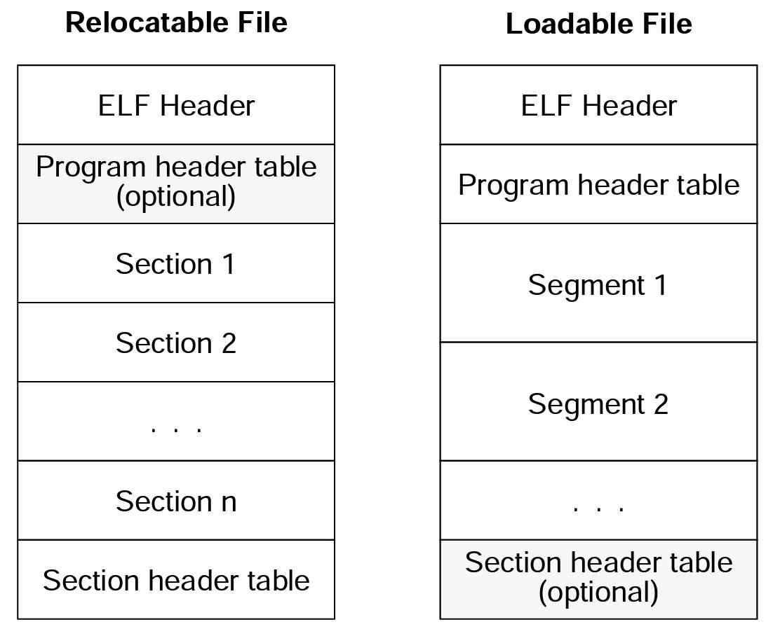
ELF-64 Object File Format, Version 1.5 Draft 2, taken from:
https://uclibc.org/docs/elf-64-gen.pdf

Slide 12
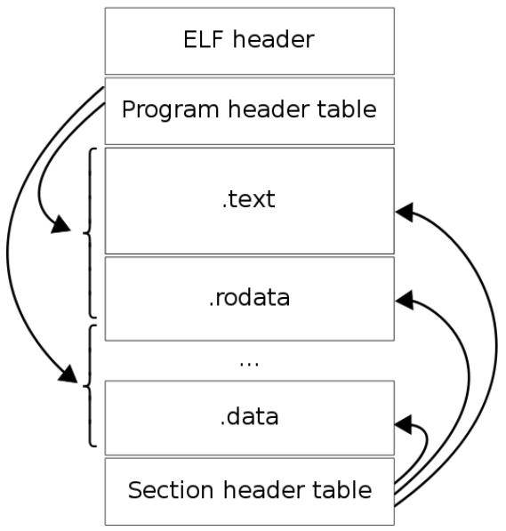
More concretely:
https://en.m.wikipedia.org/wiki/Executable_and_Linkable_Format

Slide 13
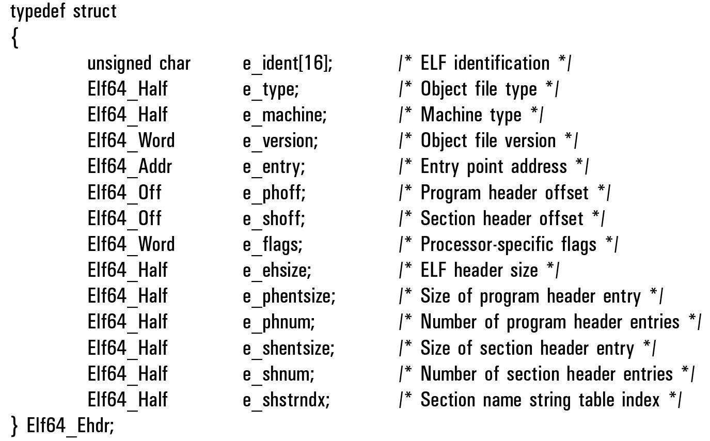
The ELF header is of the following format:
ELF-64 Object File Format, Version 1.5 Draft 2, taken from:
https://uclibc.org/docs/elf-64-gen.pdf

Slide 14
The ELF header contains among other things:
A magic (constant sequence of bytes (‘\x7fELF’)).
Basic information about the machine the ELF is compiled for.
The subtype of the object file.
The offsets and sizes, in the file’s data, of the program and section header tables.
The address of the “entry point” if the ELF is an executable.
Additional data used to “parse” the file.

Slide 15
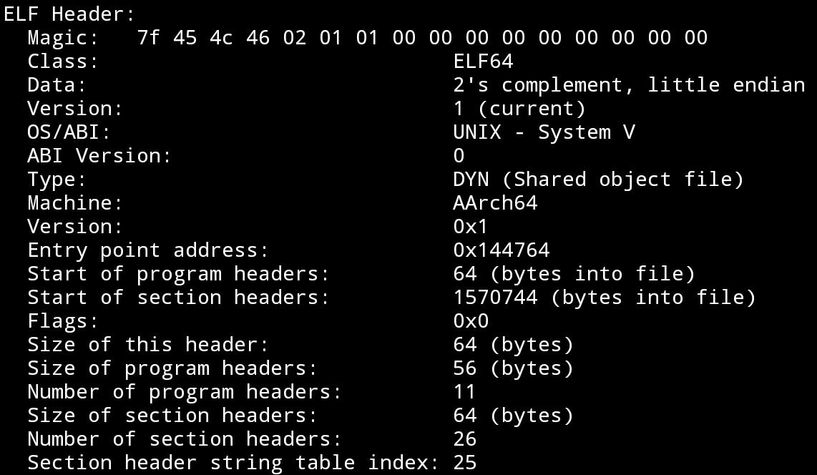
Typically looks something like (the ELF header taken from an executable on a 64 bit ARM (AARCH64) device):

Slide 16
The two initial structures describing the ELF for linking / loading are the section / program header tables respectively.
These are two arrays of entries of section header entry / program header entry respectively.
The section headers and sections:

Slide 17
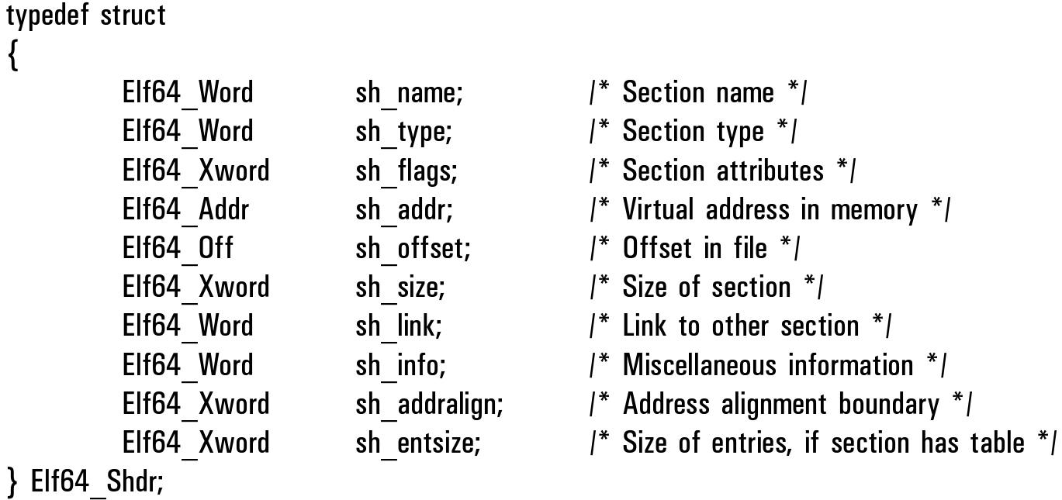
Section header entry:

Slide 18
Sections
The section header table divides different parts of the file to sections, which are used by the static linker for locating specific code and data in the file, locating refences to code and data of other object files, and other things required for the linking process.
Common section types, and common sections that exist in object files are:

Slide 19
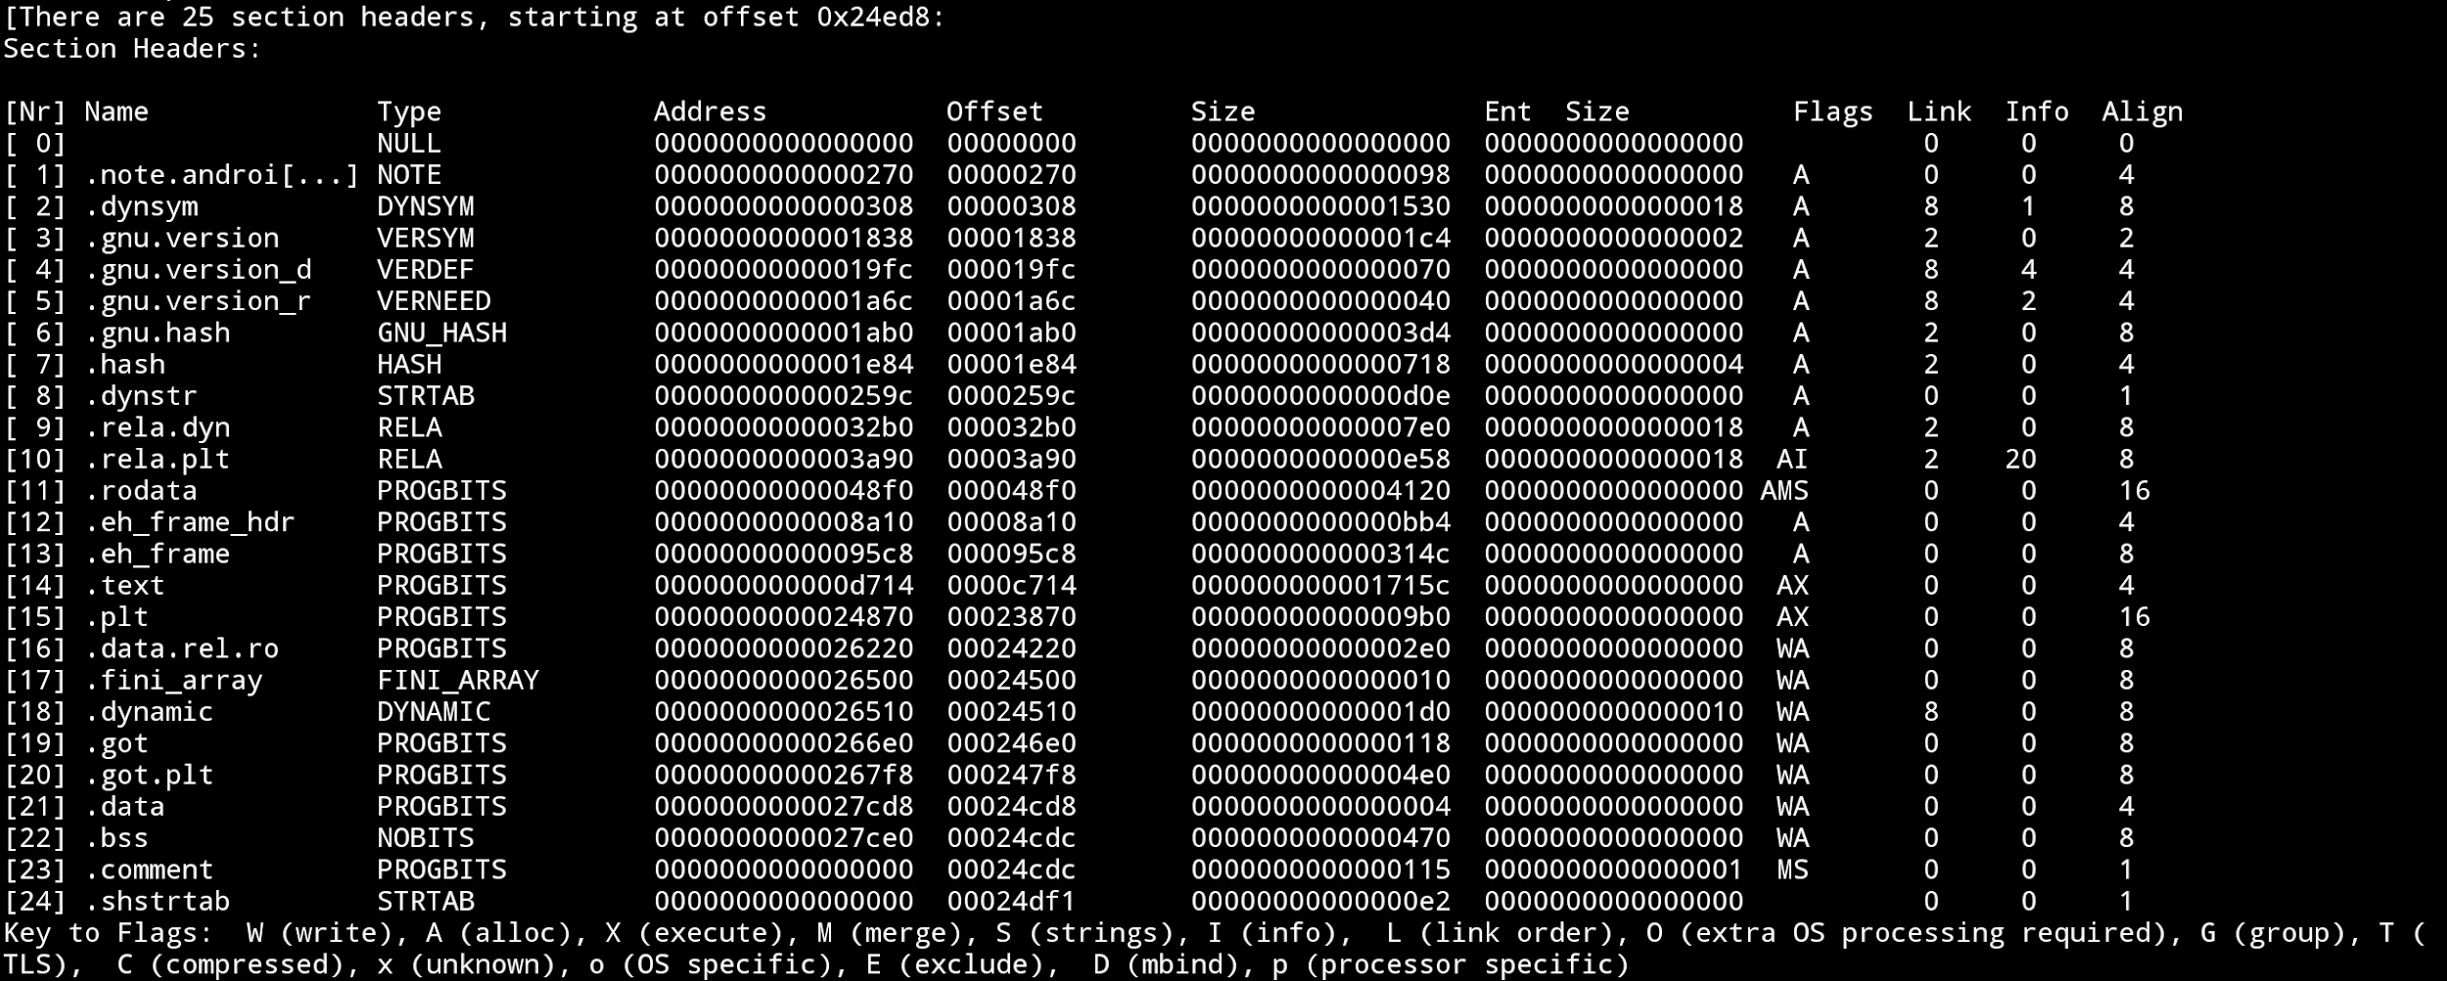
Example of a dump (formatted) using the readelf tool (a shared object in android aarch64)

Slide 20
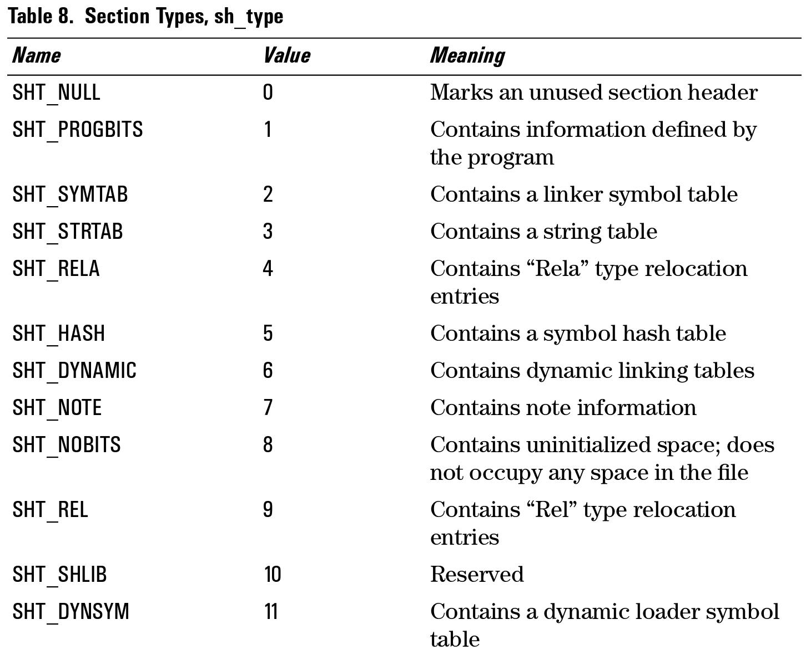
ELF-64 Object File Format, Version 1.5 Draft 2, taken from:
https://uclibc.org/docs/elf-64-gen.pdf

Slide 21
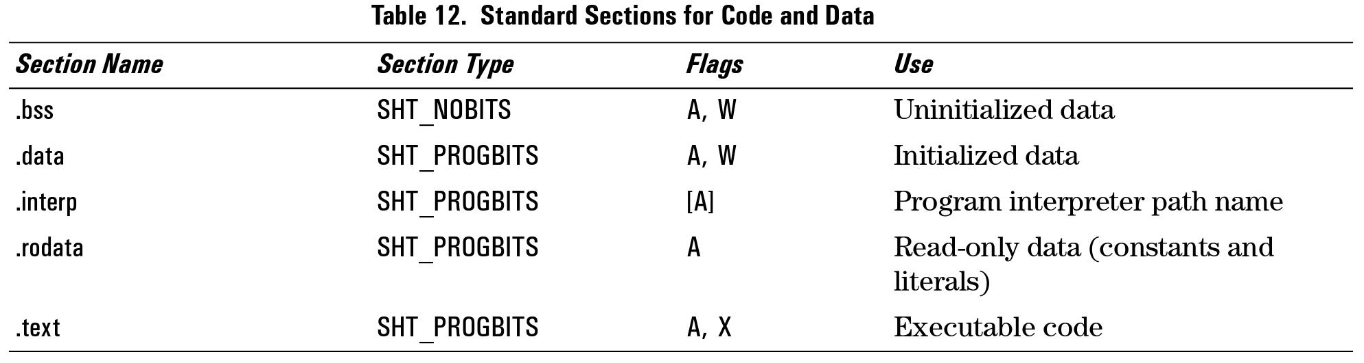
Common sections that exist in object files are:
ELF-64 Object File Format, Version 1.5 Draft 2, taken from:
https://uclibc.org/docs/elf-64-gen.pdf
The “.text” section typically contains compiled code, the “.data” section initialized global data and variables, “.bss” uninitialized data.
and other common sections:

Slide 22
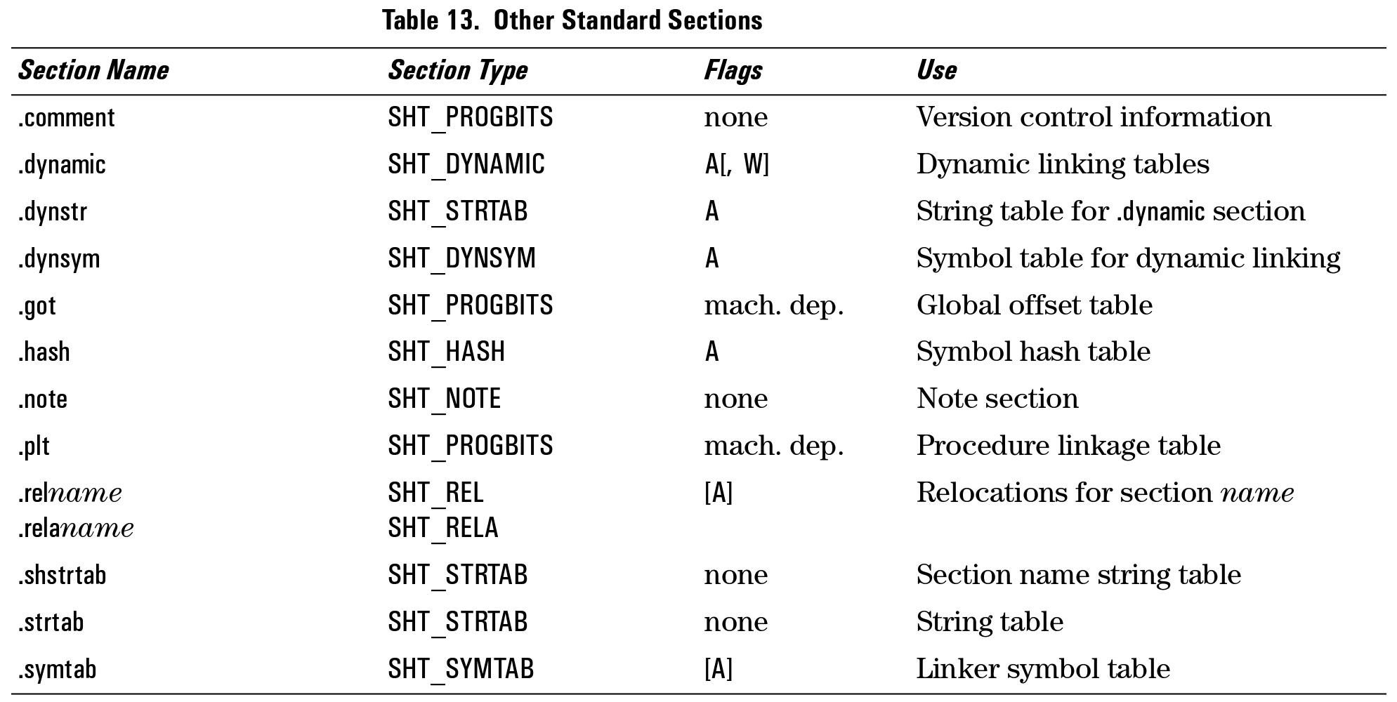

Slide 23
Three data structures are widely used for static linking are string tables, symbol tables and relocation tables.
String tables are used for holding strings.
They are used as “tables” which are indexed via offsets to get strings, as it is convenient for other tables elements to be of constant sizes.
The symbol / dynamic symbol string table is indexed by symbol entries for names of symbols in the symbol / dynamic symbol table respectively (we will shortly see).
The section headers string table is indexed by section header entries to retrieve the names of sections (which is why the section headers string table has a special entry type in the section header table).
Dumps of various tables from libctf.so:

Slide 24
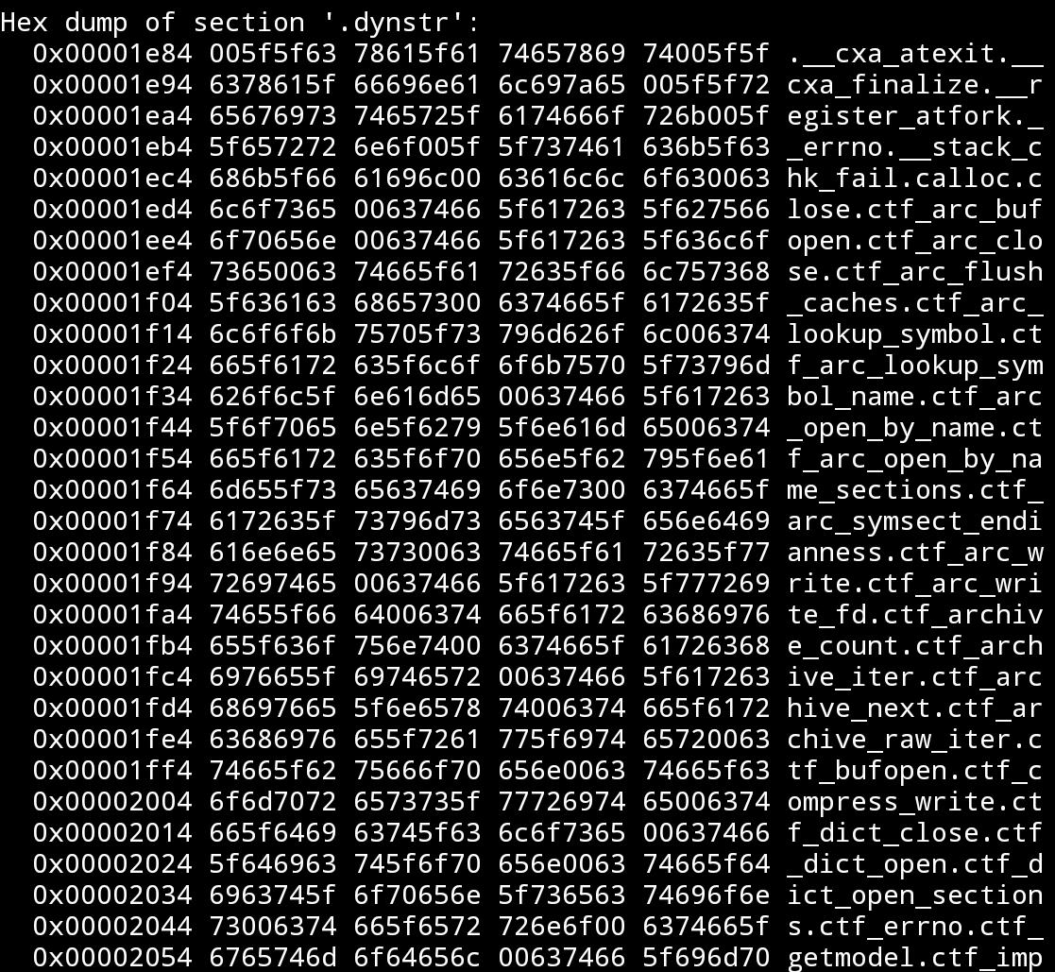
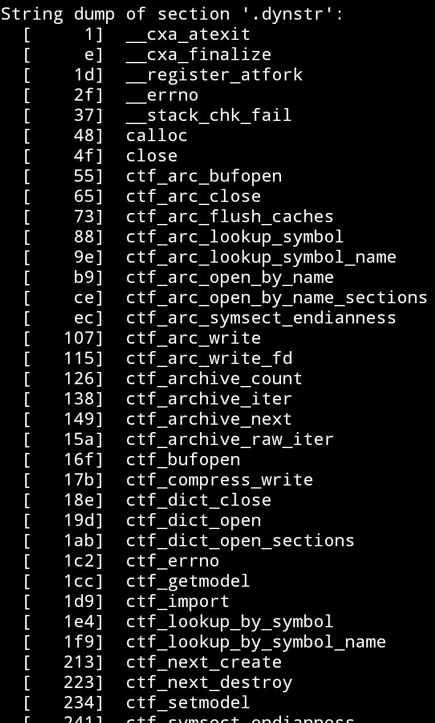

Slide 25
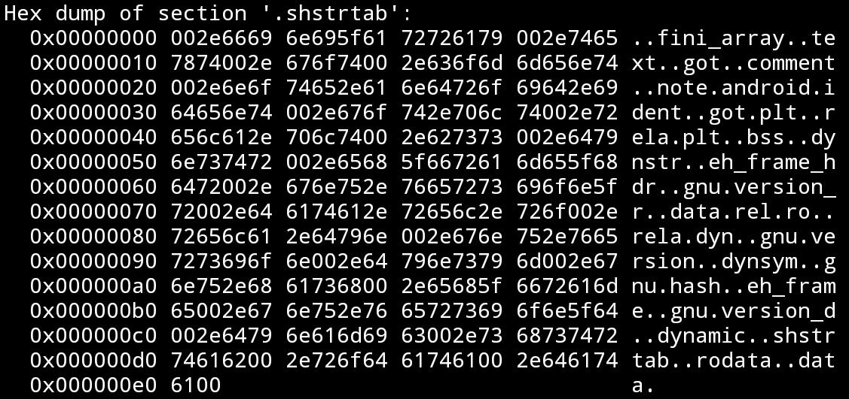

Slide 26
Symbol tables are (arrays of symbol table entries) used to indicate where different named pieces of code and data (“symbols”) reside in the file. They are used both by the static linker (symbol table) and the dynamic linker (dynamic symbol table) to resolve the addresses and content of different elements in the object files.
Examples:
A relocatable object file a.o references a function F in a second b.o. The static linker can use the symbol entry that the compiler defines for F in b.o, to get it’s data and size, insert it into a.o, and ensure that the correct reference is made into a.o by the referencing code in a.o (via relocations which we will see shortly).
An object file x.o which will link to an executable x, wants to be able to use some data V in a shared object b.so. At execution, the dynamic linker, upon loading x*, can use the dynamic symbol entry of the data V in b.so’s dynamic symbol table to resolve the adderss of V in b.so (which has been loaded into the memory) and ensure that the code in x references that address.
* or via other shananigans we will not go into currently, if you interested, search for “lazy binding”.

Slide 27
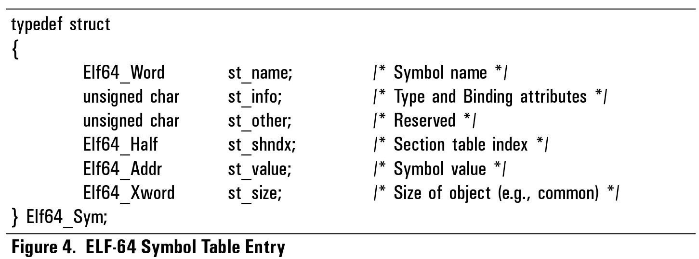
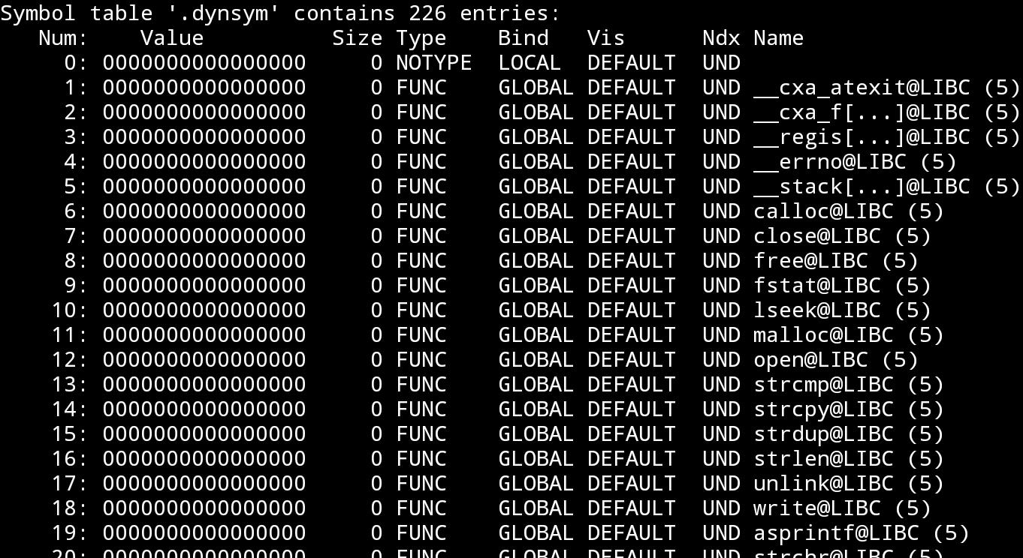
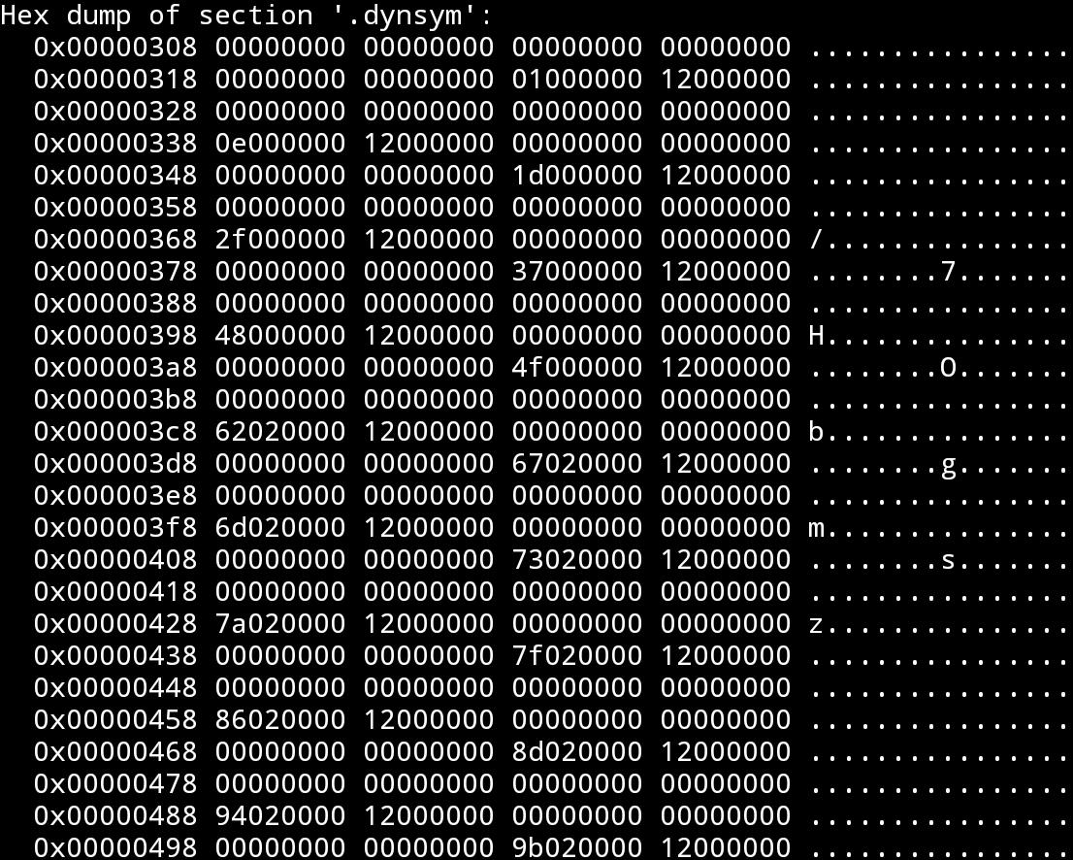
Entry structure:

Slide 28
Relocation tables (are arrays of reloc table entries).
They are inserted by the compiler and the static linker, to indicate where the static linker (for relocatable objects) / dynamic linker need to preform “relocations” (or “fixups”), usually for data that was not / could not be present during the compilation.
They are used both by the static linker and the dynamic linker to fixup addresses and instructions that are used to access the specific code / data.
Examples:
A relocatable object file a.o calls a function F in a second object b.o*. The compiler can use a relocation entry to record that the part of the code at the specific call instruction, that encodes the offset of the call instruction, needs to be fixed by the static linker to the offset in the merged object file of a.o and b.o, of the function F relative to that call instruction. When the static linker merges the object files, it will know it’s needs to preform this “fixup”.
* To be precise, when the compiler creates the relocation entry for F, it only knows that F is a symbol which does not exist
in the current object file (aka “external symbol”) and therefore needs to be “resolved”. If the static linker fails to find a
definition of F in one of the objects it merges when invoked with a.o, it will give the “famous” linking error.

Slide 29
Some code in an object file x.o (which will the linker will link to an executable x), wants to be able to use some variable V in a shared object b.so. The static linker, when linking x into an executable, can insert a relocation entry in x’s table to encode that the dynamic linker, when loading x into the memory, should encode the address of the variable V (which lies in the loaded shared object b.so), at the instruction that references it in x, in the memory.
The dynamic linker, when loading x upon execution, can use this entry to
know it should find the address of V (in the loaded b.so) and preform the
fixup in x’s loaded code.
The actual fixup operation of the relocation is highly dependent on the machine instruction encoding and architecture.
Nevertheless there are some basic concepts and ideas in the implementation of major architectures that are shared, and some general operations, have “generic” relocation types dedicated for them, such as adding an offset to a value at an address, writing an address of a symbol to some address etc.
The operand type and value / desired value, are encoded into the entry.

Slide 30
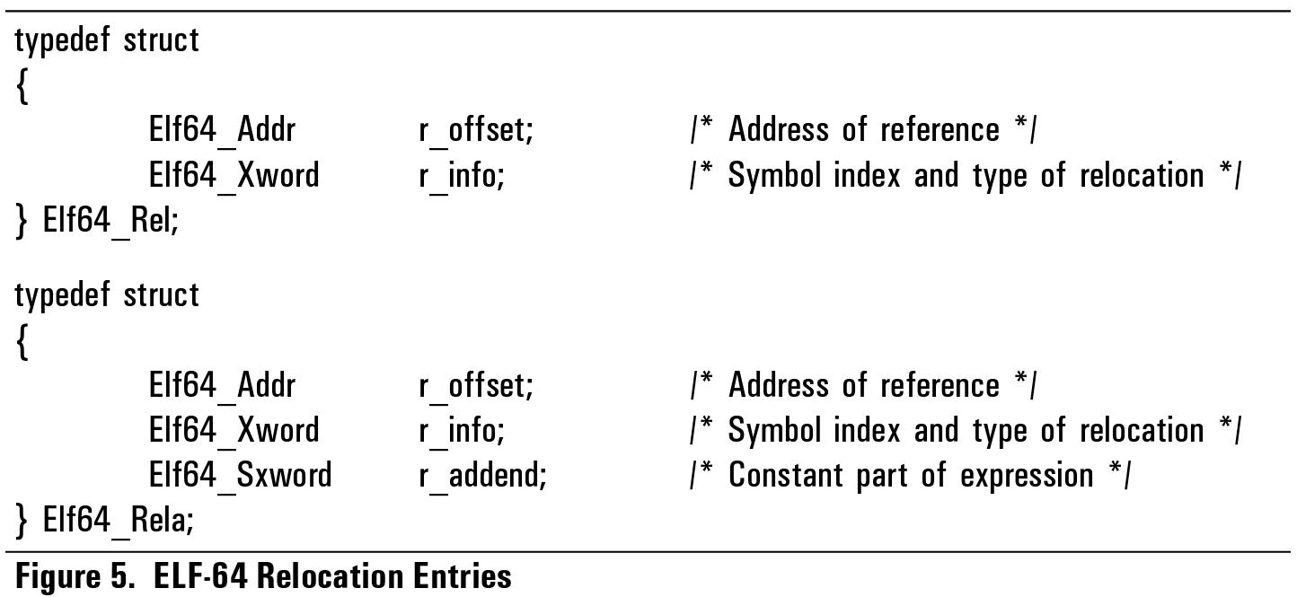
The structure of a relocation (and relocation with addend) entry:

Slide 31
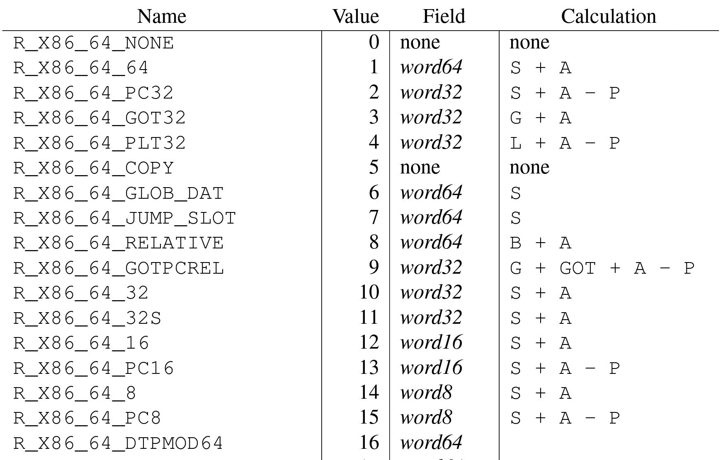
Some common relocation types (for x86-64 are):
ELF-64 Object File Format AMD64 supplement:
https://refspecs.linuxbase.org/elf/x86_64-abi-0.99.pdf

Slide 32
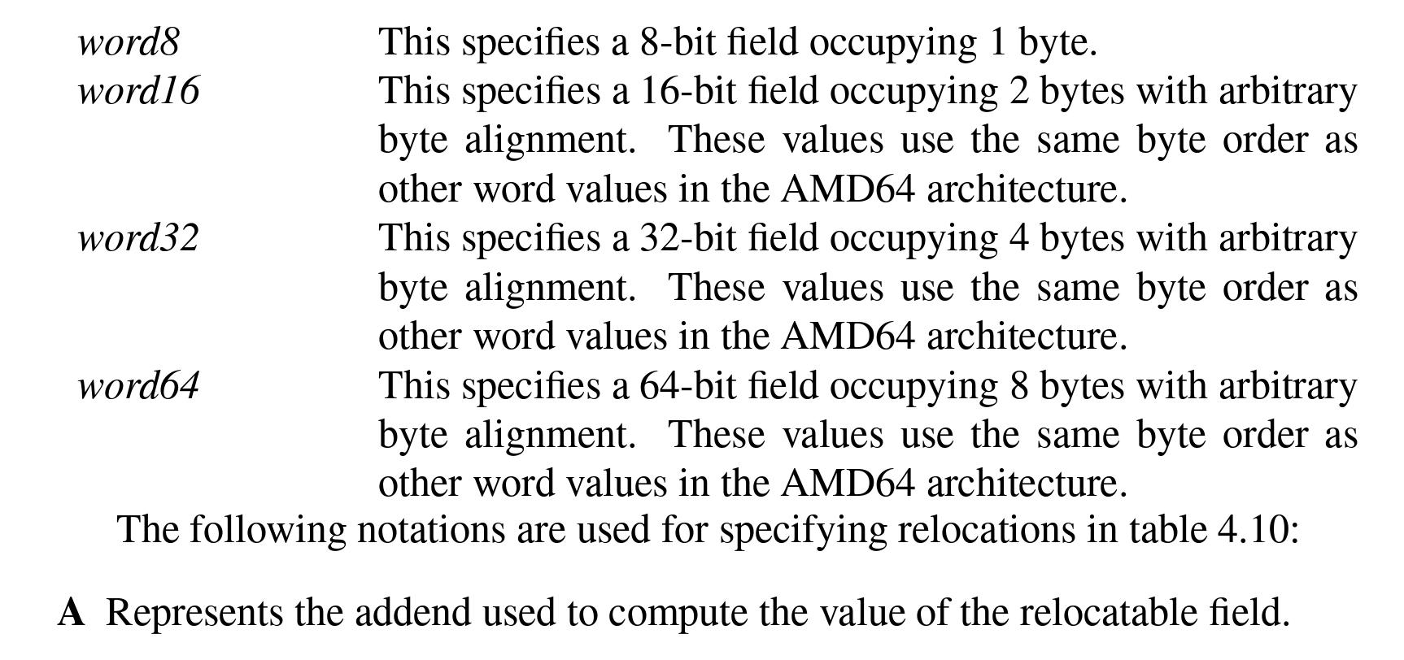
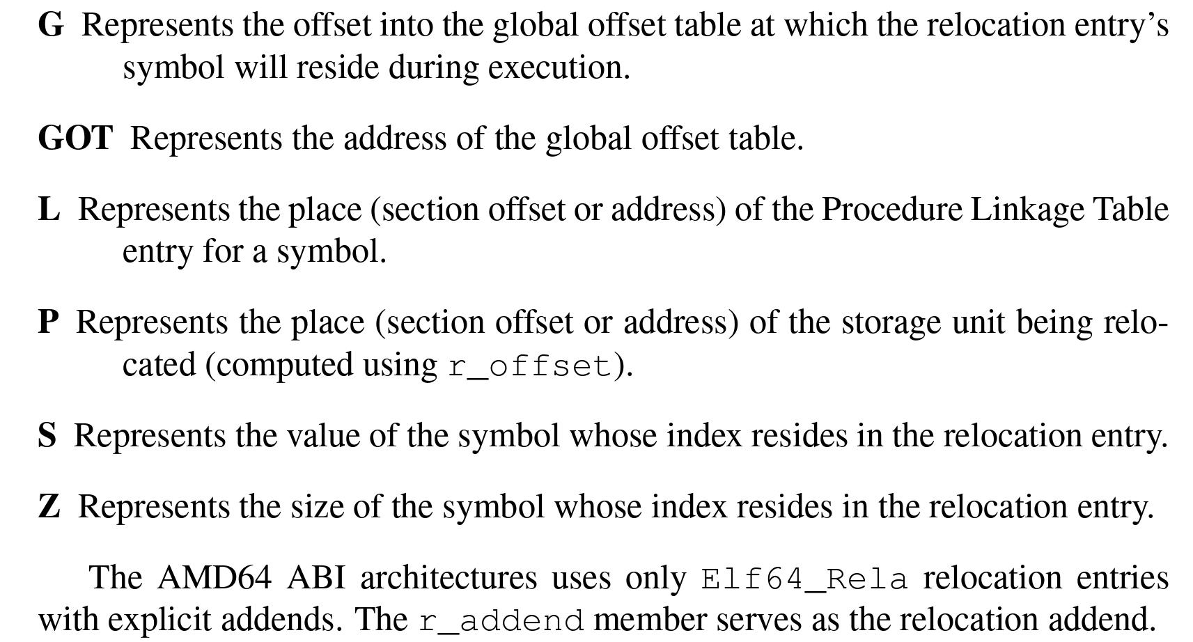

Slide 33
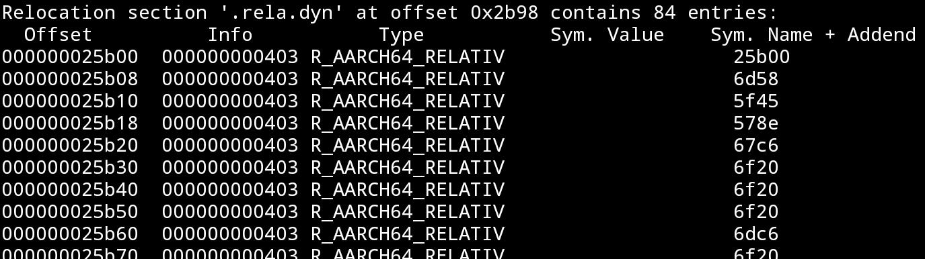
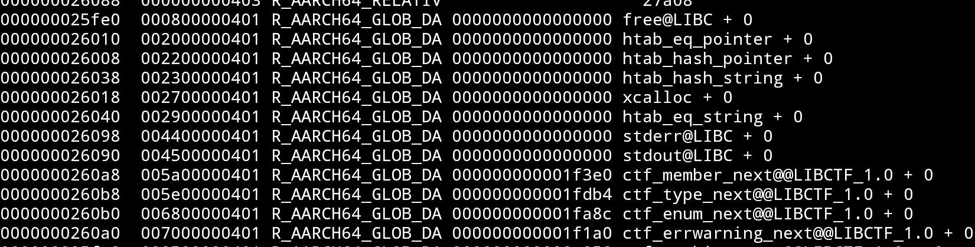
….

Slide 34
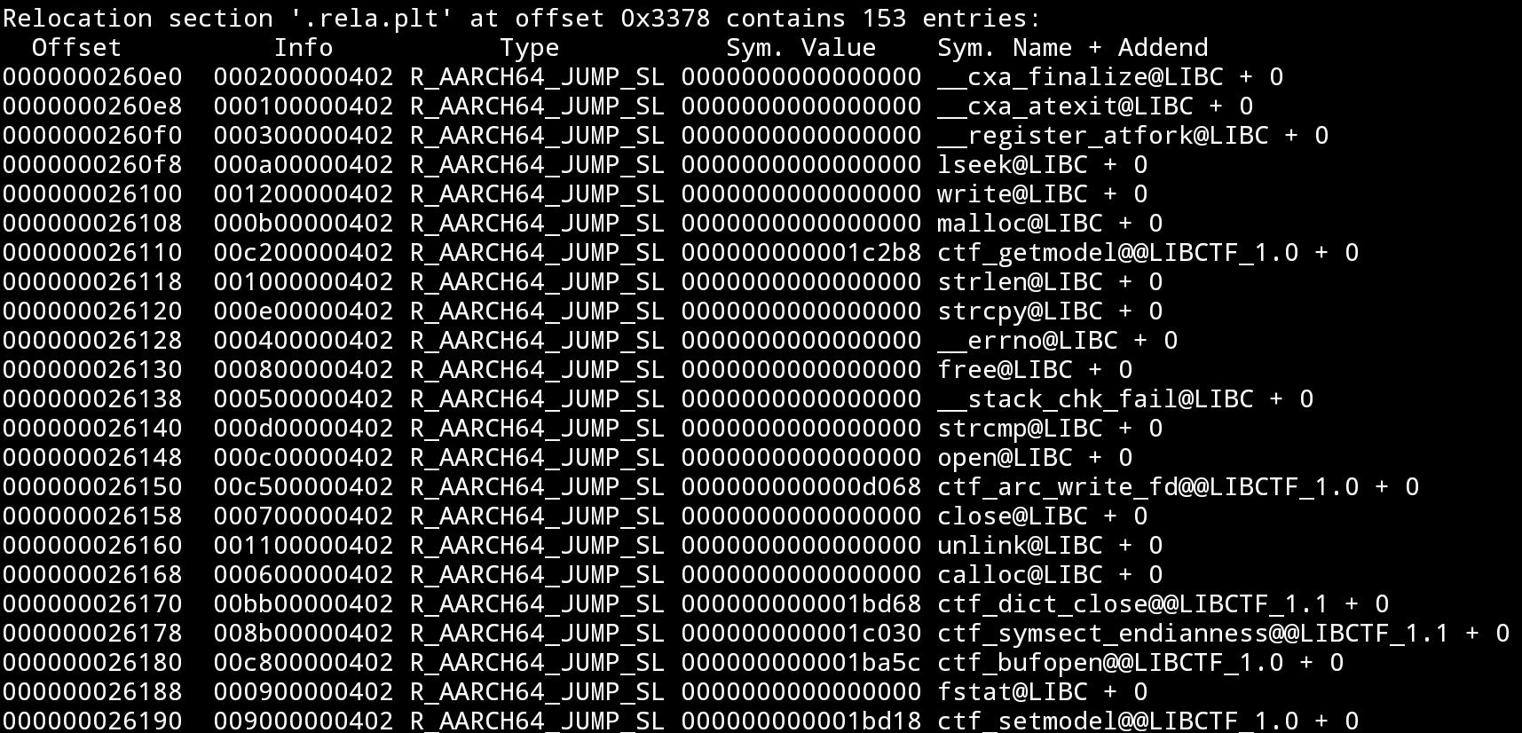

Slide 35
Segments
The program header table divides different parts of the file to (parts of) segments, which are used by the loader (and the dynamic linker), at runtime, for things such as loading the file (an executable or shared object) into the memory, locating specific code and data in the mapped image of the file, locating refences to code and data of in the mapped images of other object files, and for other things required for the loading process and the dynamic linking process.
Program header entry structure:

Slide 36
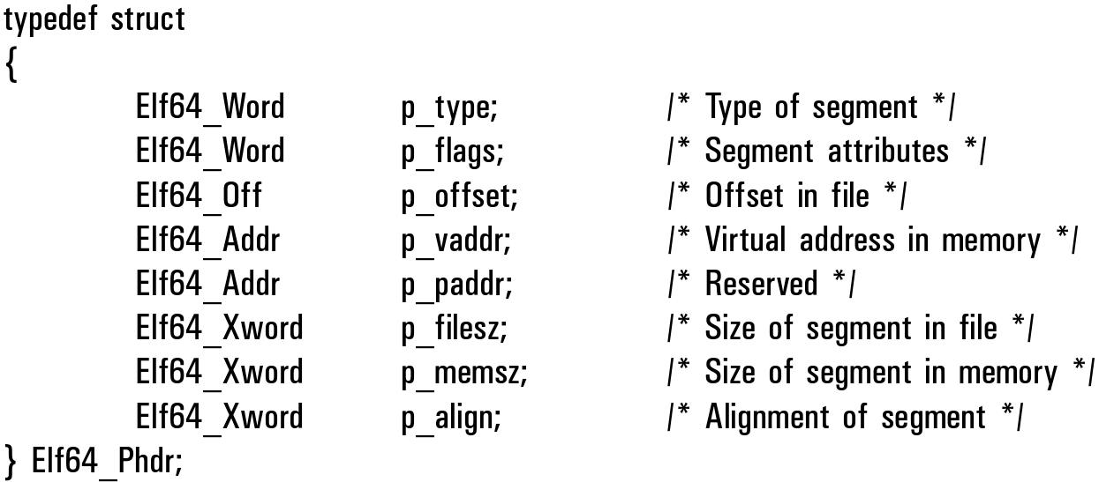
Program header entry:

Slide 37
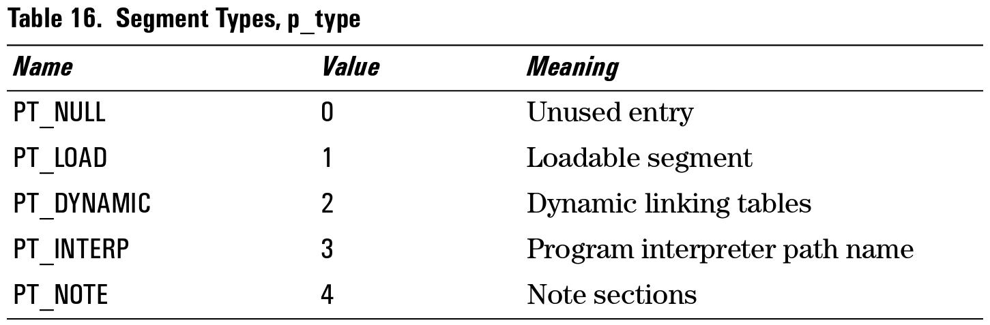
Common segment types (executable and shared object files) are:

Slide 38
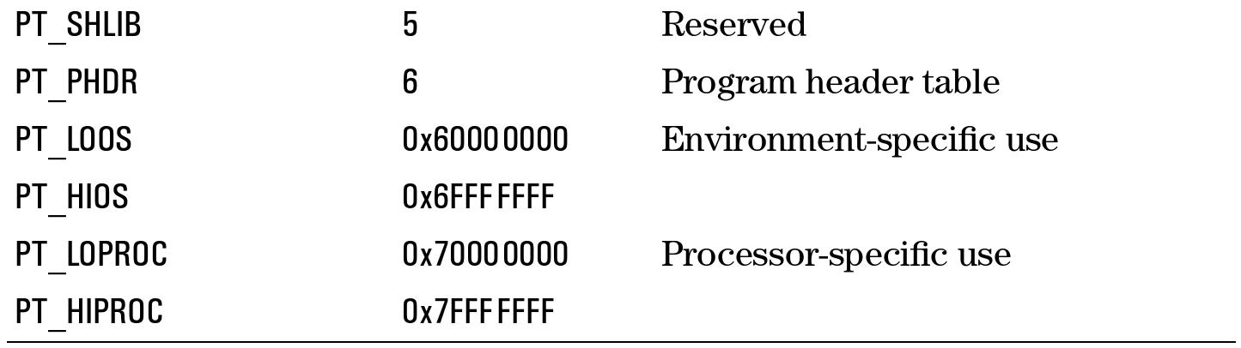
The dynamic segment has a special role in the loading and linking processes.
It contains entries which store the information which is used for the loading and dynamic linking of an executable / shared object, which includes:
Shared libraries needed by the object (for code and data).
Symbol tables of required symbols, and exported symbols.
Relocation table of required relocations.
String tables.
Initialization and Finalization functions.

Slide 39
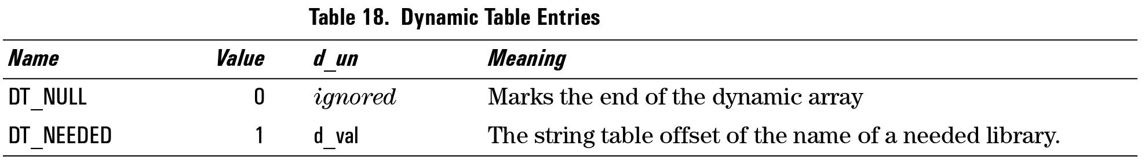
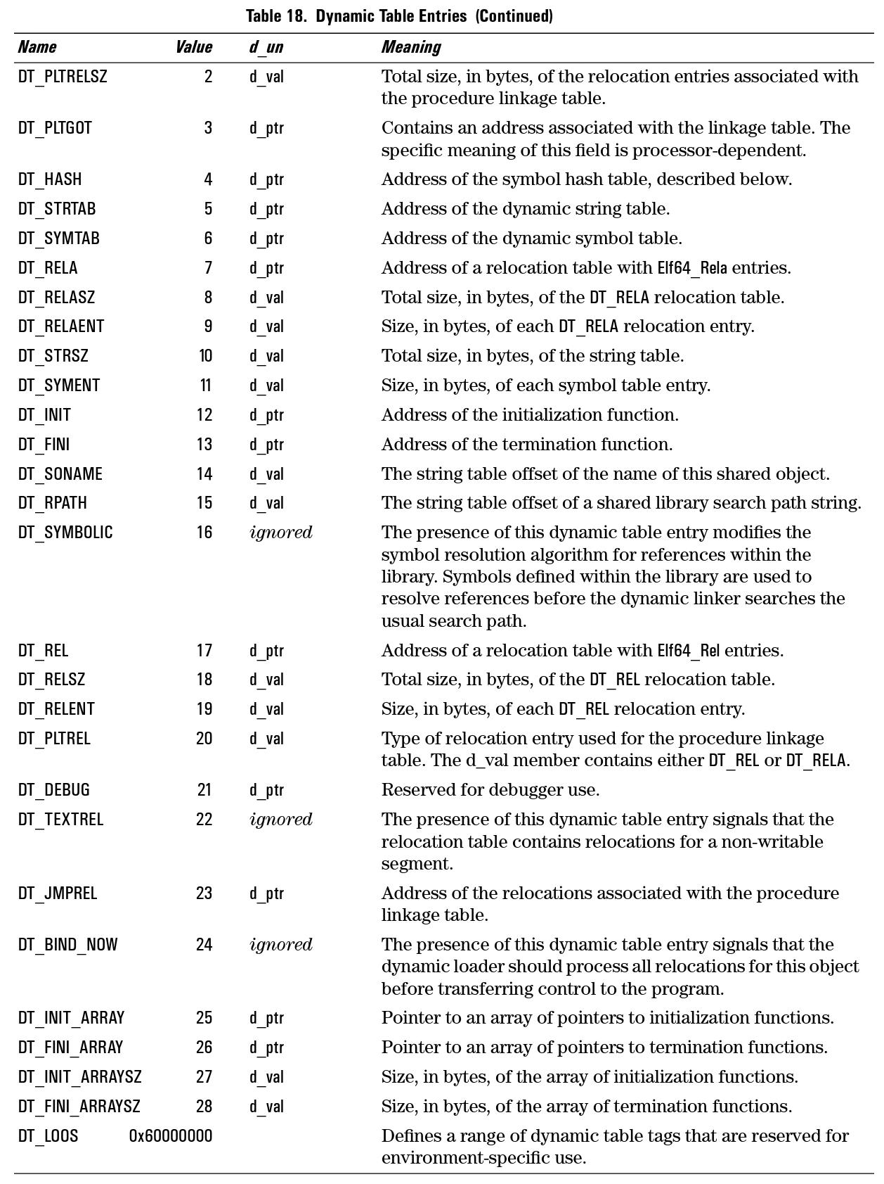

Slide 40
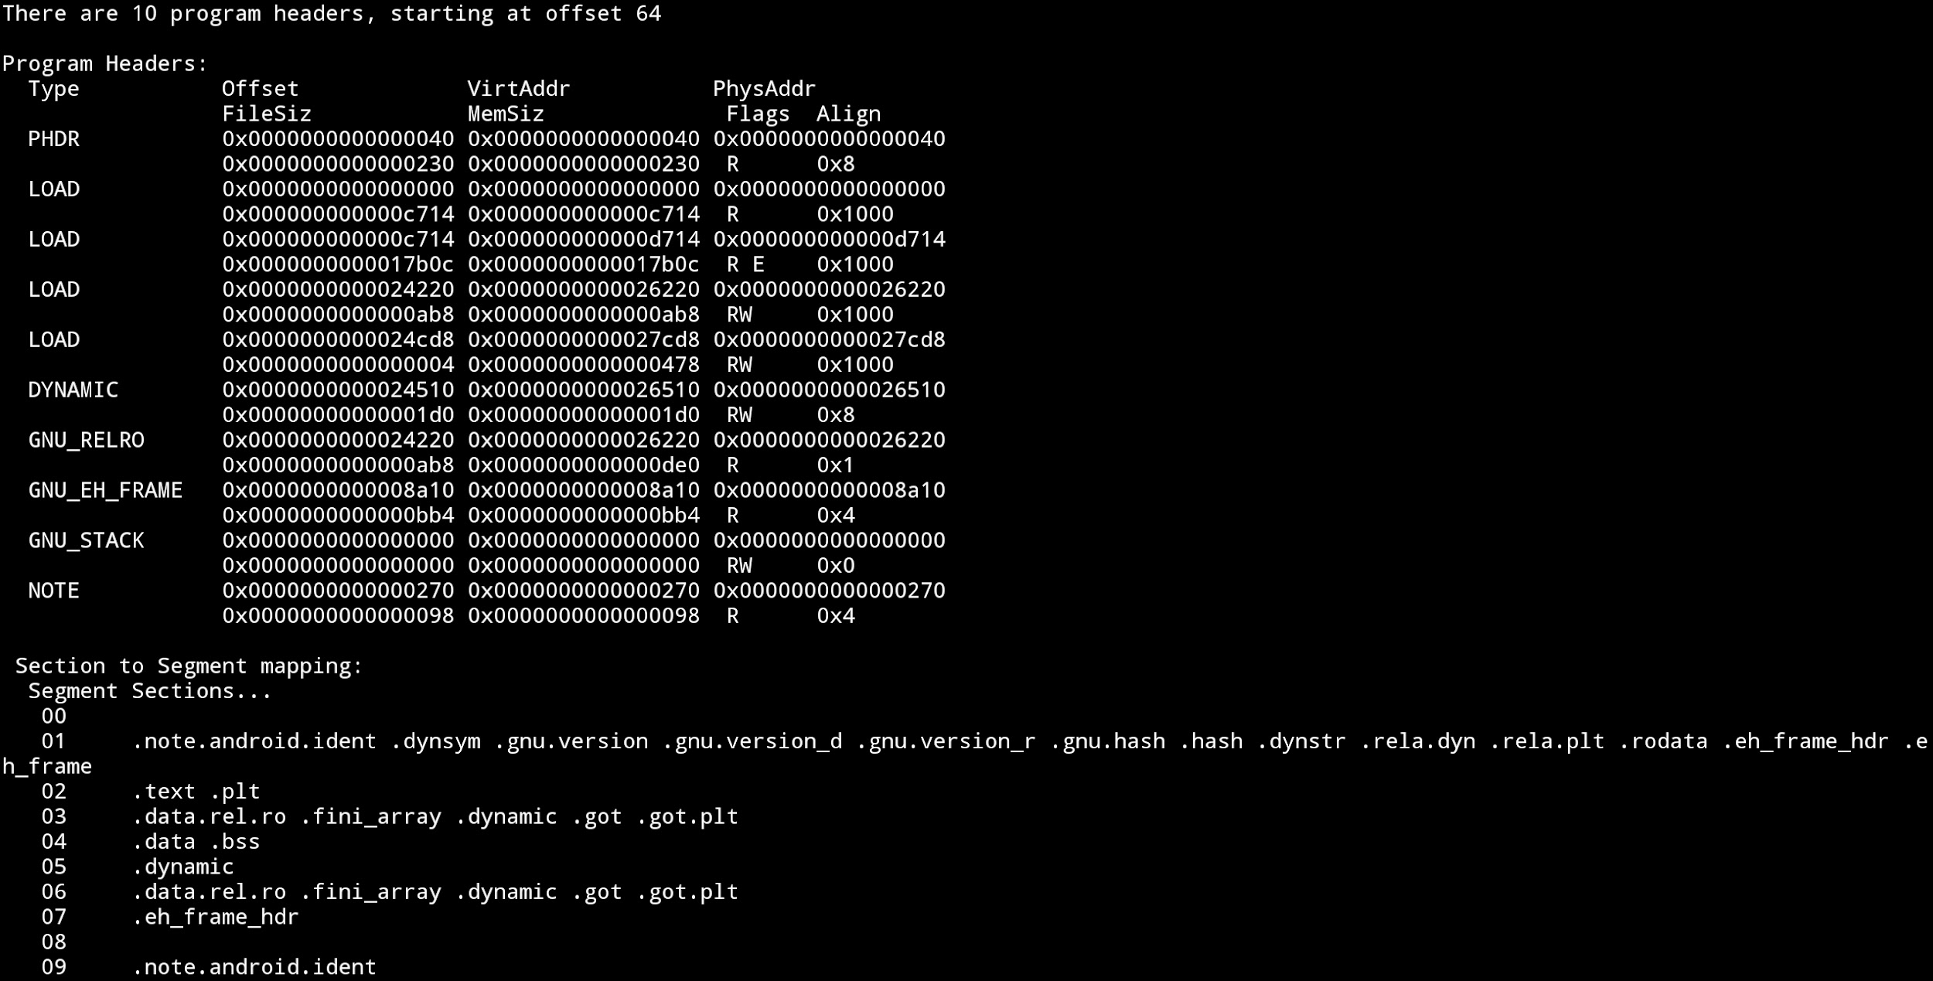
(Formatted) Dump of segment headers

Slide 41
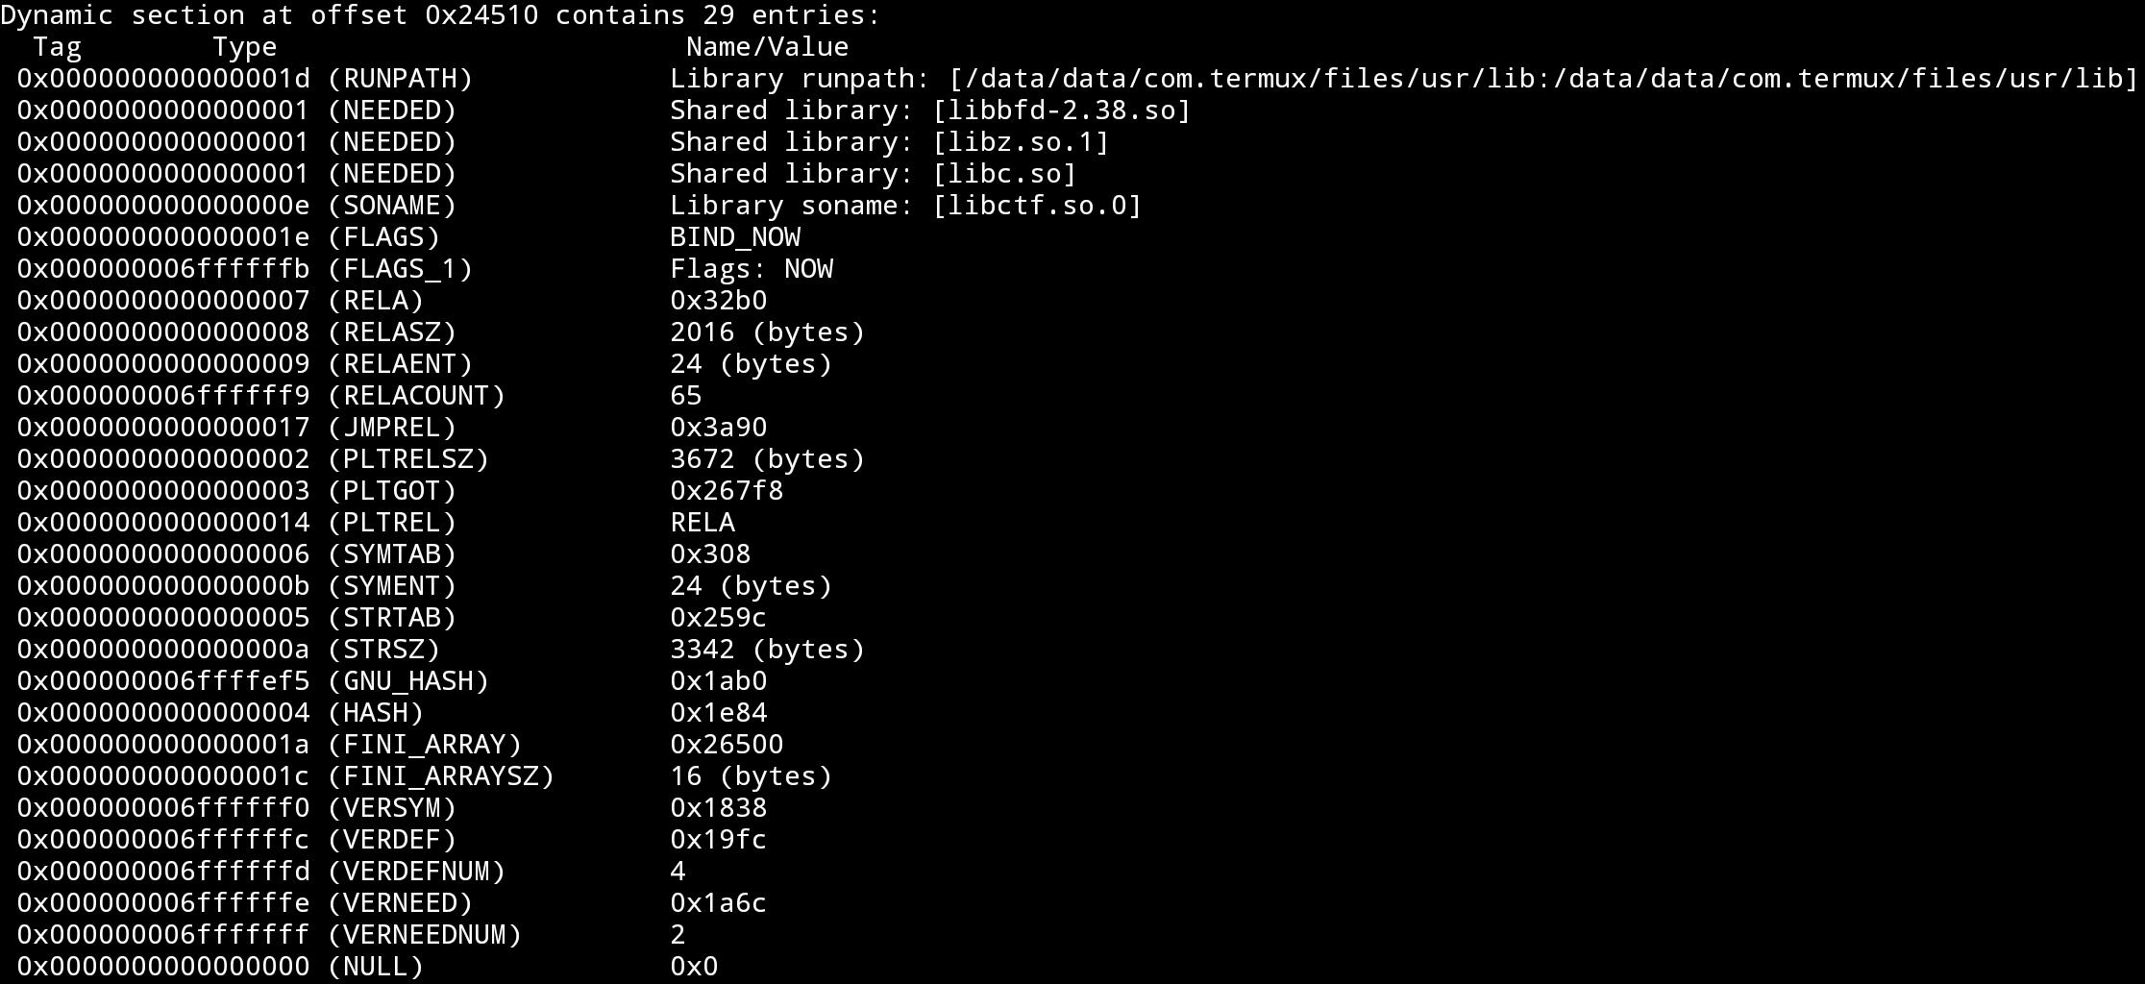
(Formatted) Dump of dynamic segment

Slide 42
Any code that loads an ELF into the memory needs to know how to parse all of this, likewise RE tools and parsers.
This is as far as we go into binary object formats for now.

